Slide 1
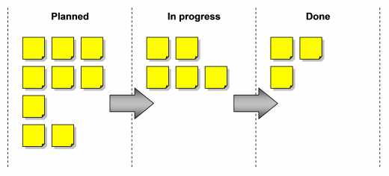

















SKTheTester@gmail.com Sivakumar Ganesan SKTheTester@gmail. com
Gherkin
Java
Features and User Stories
Test Cases
Step Definitions
Sivakumar Ganesan SKTheTester@gmail.com Sivakumar Ganesan SKTheTester@gmail.com Sivakumar Ganesan SKTheTester@gmail. com Sivakumar Ganesan
Java
Bugs
Sivakumar Ganesan
http://skg.securyber.com
Test Scripts
SKTheTester@gmail.com Sivakumar Ganesan SKTheTester@gmail. Com Sivakumar Ganesan SKTheTester@gmail.com Sivakumar Ganesan SKTheTester@gmail.com
Reports
Sivakumar Ganesan SKTheTester@gmail.com Sivakumar Ganesan
Central Repository
and Revision Control
Applications
Notes:
Developed this plain vanilla automation framework using open source tools for a client when their organization moved from a waterfall to agile methodology. The Behavioral driven development using Gherkin and Cucumber replaced the legacy automation framework. It brought in transparency and high reuse, enabling progressive automation within the sprints. Achieved ~80% in-sprint automation across teams within 6 months.

Slide 2
Gherkin
Java
Features and User Stories
Test Cases
Step Definitions
Java
Bugs
Test Scripts
Reports
Central Repository
and Revision Control
Applications

Slide 3





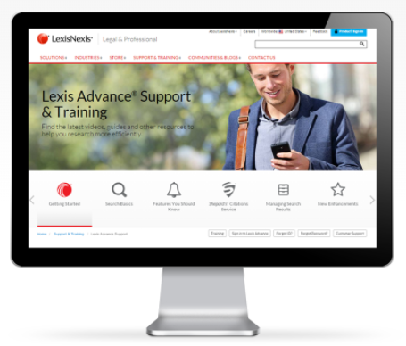

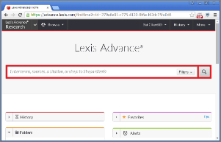













SKTheTester@gmail.com Sivakumar Ganesan SKTheTester@gmail. com
Gherkin
Code
ATOM
Business Requirements
Features and User Stories
Test Cases
Step Definitions
Sivakumar Ganesan SKTheTester@gmail.com Sivakumar Ganesan SKTheTester@gmail.com Sivakumar Ganesan SKTheTester@gmail. com Sivakumar Ganesan
Code
Test Data
Instructions
Bugs
Applications
Dynamic Test Data
Generation
Test Scripts
Automated
Bug Tracking
SKTheTester@gmail.com Sivakumar Ganesan SKTheTester@gmail. Com Sivakumar Ganesan SKTheTester@gmail.com Sivakumar Ganesan SKTheTester@gmail.com
Automated Continuous Test Pipeline
Regression
In-Sprint
Smoke
BVT
Central Repository & Revision Control
Expert Reports and Dashboards
Custom Tools built in-house
Selenium & Other Open Source Tools
Sivakumar Ganesan SKTheTester@gmail.com Sivakumar Ganesan
Continuous Integration
Reusable custom tools
Sivakumar Ganesan
http://skg.securyber.com
Notes:
While the cucumber framework increases re-use and reduces effort spent in result analysis, considerable effort is still required in running them as data-driven tests. Implemented a cucumber hook that enables defining the test data instructions rather than actual test data in the test case. It will dynamically pull the test data in runtime and pass it to the test case there by reducing effort spent in test data preparation. Introduced automatic bug tracking as well to further reduce the overheads in the testing processes.

Slide 4
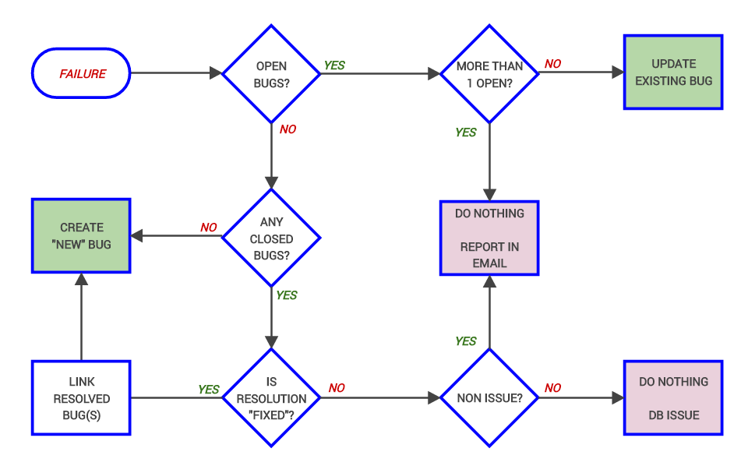
SKTheTester@gmail.com Sivakumar Ganesan SKTheTester@gmail. com
Sivakumar Ganesan SKTheTester@gmail.com Sivakumar Ganesan SKTheTester@gmail.com Sivakumar Ganesan SKTheTester@gmail. com Sivakumar Ganesan
Sivakumar Ganesan
http://skg.securyber.com
SKTheTester@gmail.com Sivakumar Ganesan SKTheTester@gmail. Com Sivakumar Ganesan SKTheTester@gmail.com Sivakumar Ganesan SKTheTester@gmail.com
Sivakumar Ganesan SKTheTester@gmail.com Sivakumar Ganesan
Notes:
Defect management – from creation, triaging and tracking till closure is another tedious test process that takes significant manual effort from testers. Introduced an automated bug management system to analyze logs from test scripts, identify and group issues, determine if they are ‘New’ or already known issue.

Slide 5




SKTheTester@gmail.com Sivakumar Ganesan SKTheTester@gmail. com
Application Logs
Applications
Sivakumar Ganesan
http://skg.securyber.com
Sivakumar Ganesan SKTheTester@gmail.com Sivakumar Ganesan SKTheTester@gmail.com Sivakumar Ganesan SKTheTester@gmail. com Sivakumar Ganesan
Code
Code
Functional and Regression
Test Scripts
Logs from Test runs
Open Source
Bug Tracking
Tool
Custom Bug Tracking
Algorithm
SKTheTester@gmail.com Sivakumar Ganesan SKTheTester@gmail. Com Sivakumar Ganesan SKTheTester@gmail.com Sivakumar Ganesan SKTheTester@gmail.com
Sivakumar Ganesan SKTheTester@gmail.com Sivakumar Ganesan
Notes:
Automated bug tracking

Slide 6

Gherkin
Code
SKTheTester@gmail.com Sivakumar Ganesan SKTheTester@gmail. com
ATOM
Business Requirements
Features and User Stories
Test Cases
Step Definitions
Code
Code
Sivakumar Ganesan SKTheTester@gmail.com Sivakumar Ganesan SKTheTester@gmail.com Sivakumar Ganesan SKTheTester@gmail. com Sivakumar Ganesan
Bugs
Feedback Loop
Data Feedback Loop –
Smart Data for Retests
Test Scripts
SKTheTester@gmail.com Sivakumar Ganesan SKTheTester@gmail. Com Sivakumar Ganesan SKTheTester@gmail.com Sivakumar Ganesan SKTheTester@gmail.com
Regression
In-Sprint
Smoke
BVT
Central Repository & Revision Control
Custom Tools built in-house
Selenium & Other Open Source Tools
Sivakumar Ganesan
http://skg.securyber.com
Sivakumar Ganesan SKTheTester@gmail.com Sivakumar Ganesan
Test Data
Instructions

Slide 7
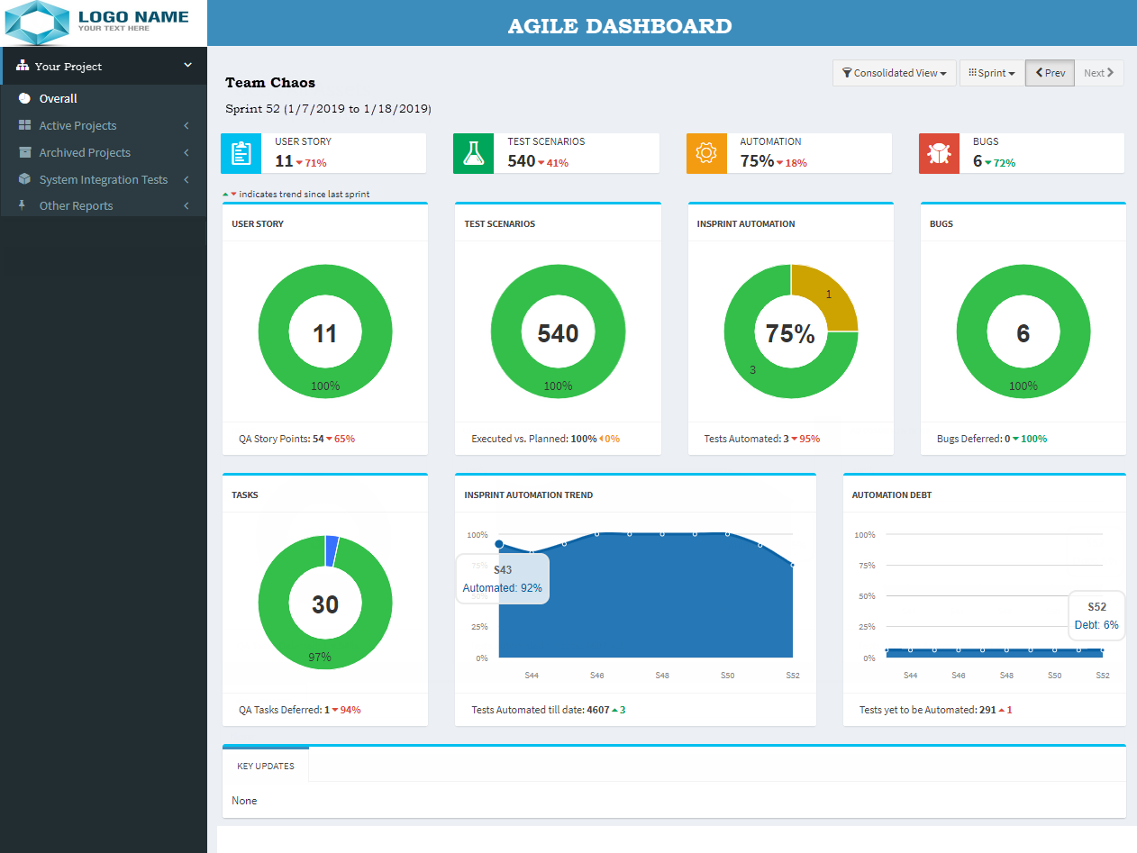
SKTheTester@gmail.com Sivakumar Ganesan SKTheTester@gmail. com
Sivakumar Ganesan SKTheTester@gmail.com Sivakumar Ganesan SKTheTester@gmail.com Sivakumar Ganesan SKTheTester@gmail. com Sivakumar Ganesan
SKTheTester@gmail.com Sivakumar Ganesan SKTheTester@gmail. Com Sivakumar Ganesan SKTheTester@gmail.com Sivakumar Ganesan SKTheTester@gmail.com
Sivakumar Ganesan SKTheTester@gmail.com Sivakumar Ganesan
Sivakumar Ganesan
http://skg.securyber.com
Notes:
Solved the problem of not having enough test metrics in AGILE projects by developing a custom dashboard with Apache, MySQL and PHP. Dashboard gets the data from tools like VSTS, VersionOne and automated test logs. The dashboard provides valuable trends that enable data-driven decision making.

Slide 8




SKTheTester@gmail.com Sivakumar Ganesan SKTheTester@gmail. com
Gherkin
Code
Central Repository
and Revision Control
Custom
Test Case Management
Algorithm
Open Source
ALM
Test Cases
Sivakumar Ganesan SKTheTester@gmail.com Sivakumar Ganesan SKTheTester@gmail.com Sivakumar Ganesan SKTheTester@gmail. com Sivakumar Ganesan
Sivakumar Ganesan
http://skg.securyber.com
SKTheTester@gmail.com Sivakumar Ganesan SKTheTester@gmail. Com Sivakumar Ganesan SKTheTester@gmail.com Sivakumar Ganesan SKTheTester@gmail.com
Parsing
Errors
Gherkin Living Documentation
Sivakumar Ganesan SKTheTester@gmail.com Sivakumar Ganesan

Slide 9
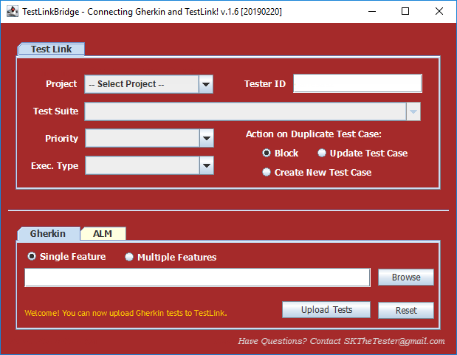
Sivakumar Ganesan
http://skg.securyber.com

Slide 10
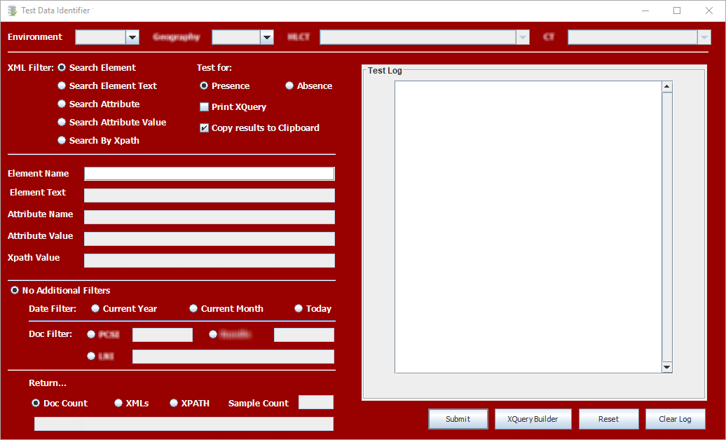
Sivakumar Ganesan
http://skg.securyber.com
Sivakumar Ganesan
http://skg.securyber.com

Slide 11
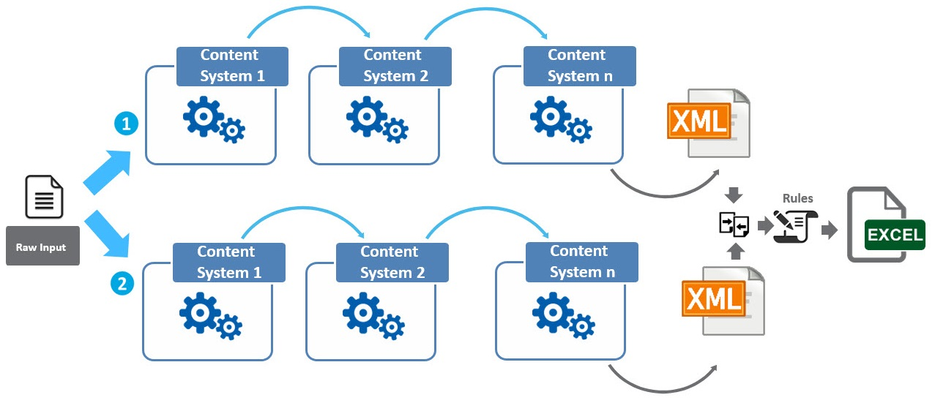
SKTheTester@gmail.com Sivakumar Ganesan SKTheTester@gmail. com
Sivakumar Ganesan
http://skg.securyber.com
Sivakumar Ganesan SKTheTester@gmail.com Sivakumar Ganesan SKTheTester@gmail.com Sivakumar Ganesan SKTheTester@gmail. com Sivakumar Ganesan
SKTheTester@gmail.com Sivakumar Ganesan SKTheTester@gmail. Com Sivakumar Ganesan SKTheTester@gmail.com Sivakumar Ganesan SKTheTester@gmail.com
Sivakumar Ganesan
http://skg.securyber.com
Sivakumar Ganesan SKTheTester@gmail.com Sivakumar Ganesan

Slide 12
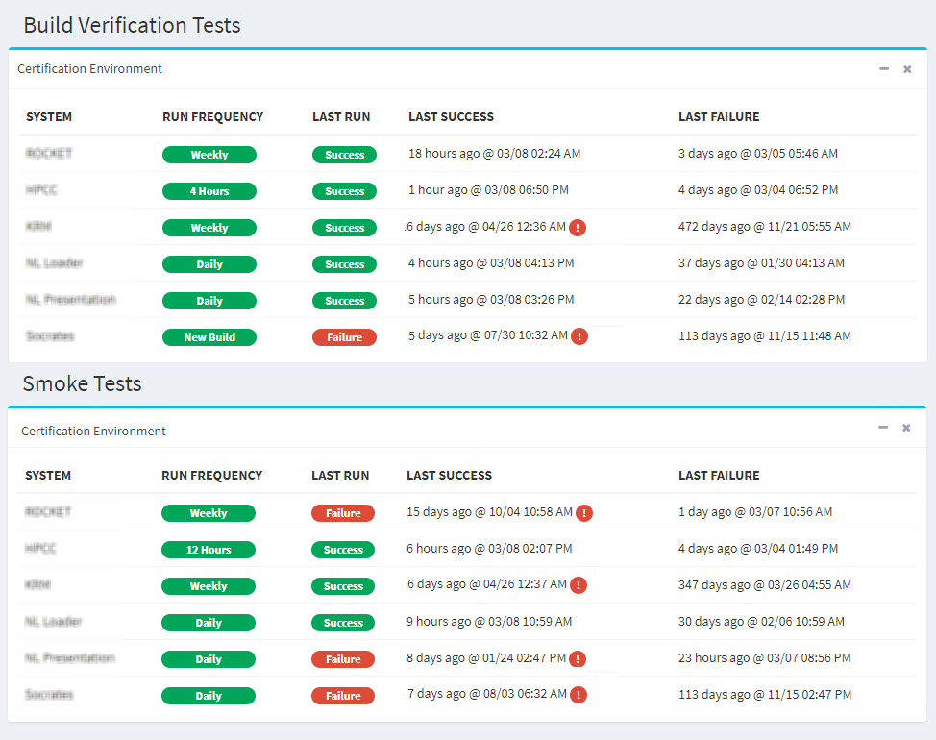
SKTheTester@gmail.com Sivakumar Ganesan SKTheTester@gmail. com
Sivakumar Ganesan SKTheTester@gmail.com Sivakumar Ganesan SKTheTester@gmail.com Sivakumar Ganesan SKTheTester@gmail. com Sivakumar Ganesan
Sivakumar Ganesan
http://skg.securyber.com
SKTheTester@gmail.com Sivakumar Ganesan SKTheTester@gmail. Com Sivakumar Ganesan SKTheTester@gmail.com Sivakumar Ganesan SKTheTester@gmail.com
Sivakumar Ganesan SKTheTester@gmail.com Sivakumar Ganesan

Slide 13


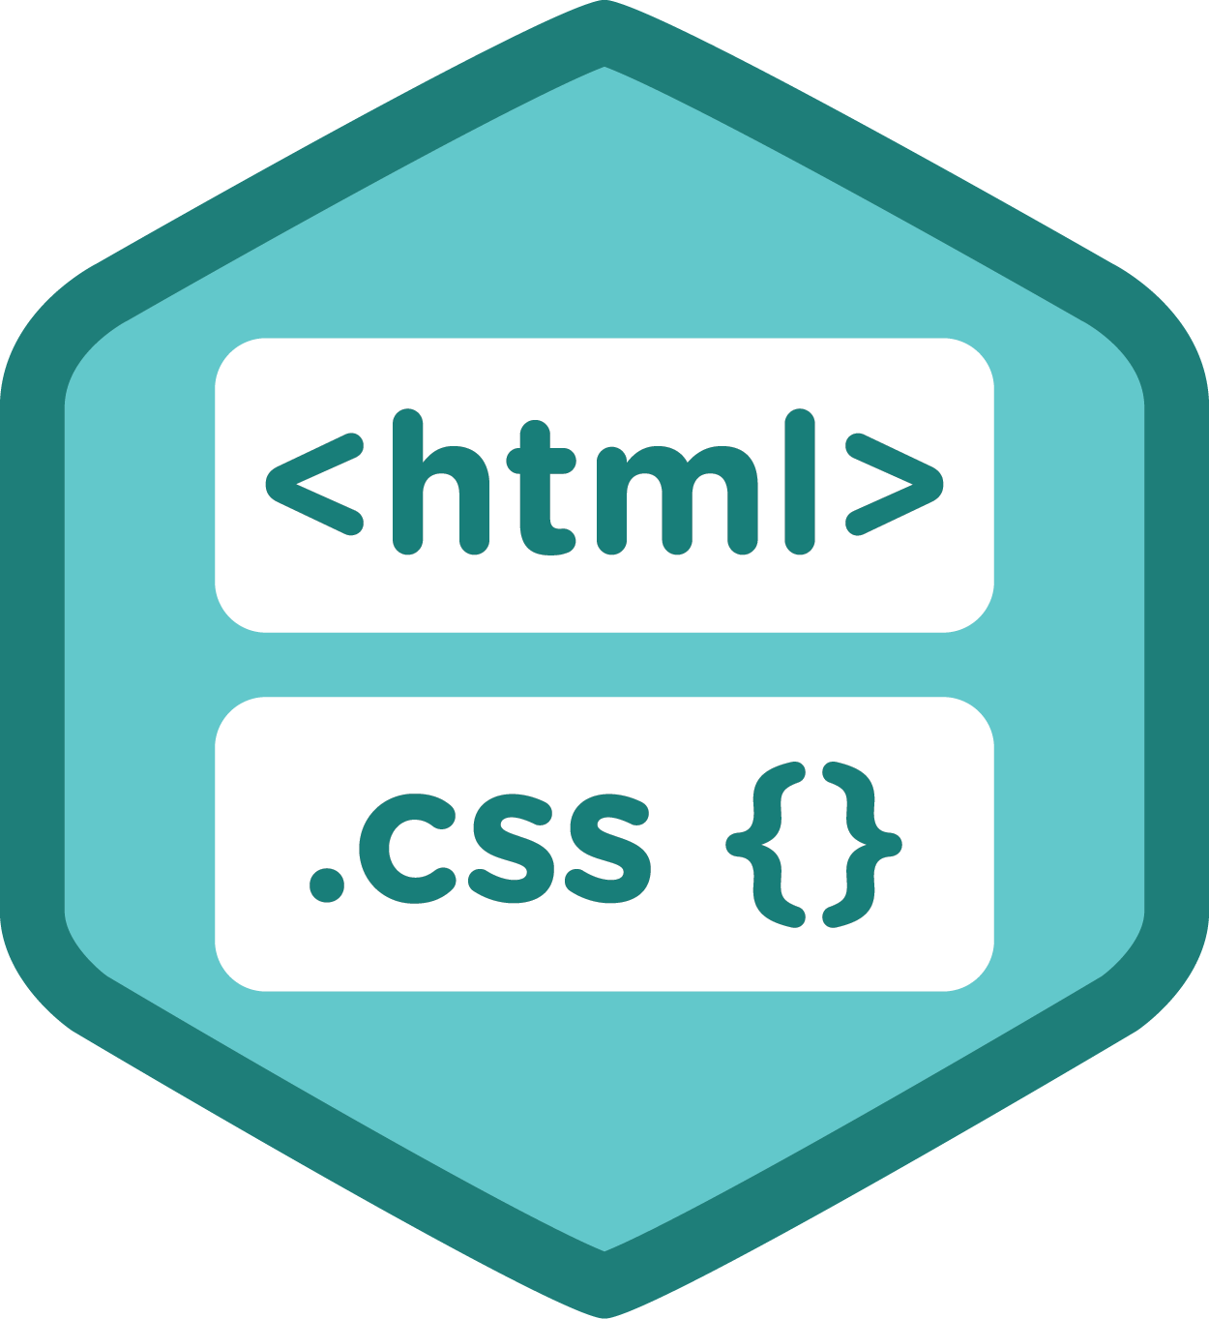










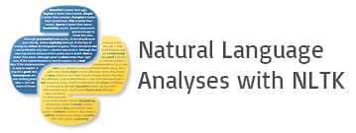

SKTheTester@gmail.com Sivakumar Ganesan SKTheTester@gmail. com
Front End – User Interface
Sivakumar Ganesan SKTheTester@gmail.com Sivakumar Ganesan SKTheTester@gmail.com Sivakumar Ganesan SKTheTester@gmail. com Sivakumar Ganesan
Users
Data Management
Analytics DB
SKTheTester@gmail.com Sivakumar Ganesan SKTheTester@gmail. Com Sivakumar Ganesan SKTheTester@gmail.com Sivakumar Ganesan SKTheTester@gmail.com
Java
Python
Jenkins
MongoDB
Existing
Data Repository
Text Analytics Platform
Sivakumar Ganesan SKTheTester@gmail.com Sivakumar Ganesan
Sivakumar Ganesan
http://skg.securyber.com

Slide 14




SKTheTester@gmail.com Sivakumar Ganesan SKTheTester@gmail. com
Production Tickets Repository
Initial Load
Mongo DB
Dashboard
Extract
Transform
Load
Sivakumar Ganesan SKTheTester@gmail.com Sivakumar Ganesan SKTheTester@gmail.com Sivakumar Ganesan SKTheTester@gmail. com Sivakumar Ganesan
Relational
DB
Sivakumar Ganesan
http://skg.securyber.com
SKTheTester@gmail.com Sivakumar Ganesan SKTheTester@gmail. Com Sivakumar Ganesan SKTheTester@gmail.com Sivakumar Ganesan SKTheTester@gmail.com
Extract, Transform and Load
Executives, Managers, Engineers and QA
Sivakumar Ganesan SKTheTester@gmail.com Sivakumar Ganesan
Every
x Minute(s)/Hour(s)
Delta Data Management
Notes:
Even though hundreds of production tickets and internal defects are handled everyday, most organizations do not have any visualization of this data to enable data driven decision making. I developed a tickets analysis and auto-resolution system by orchestrating a number of carefully selected open source tools.

Slide 15
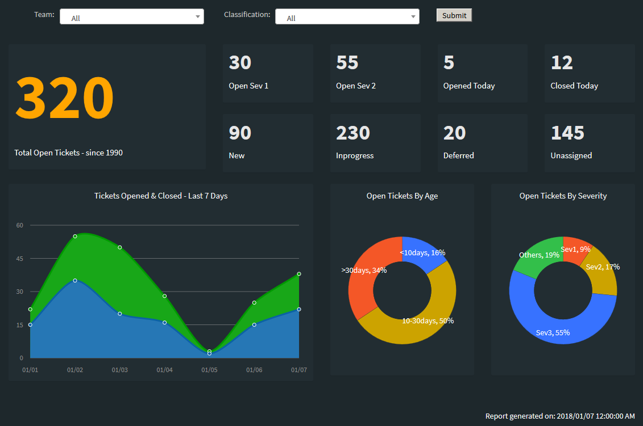

Slide 16
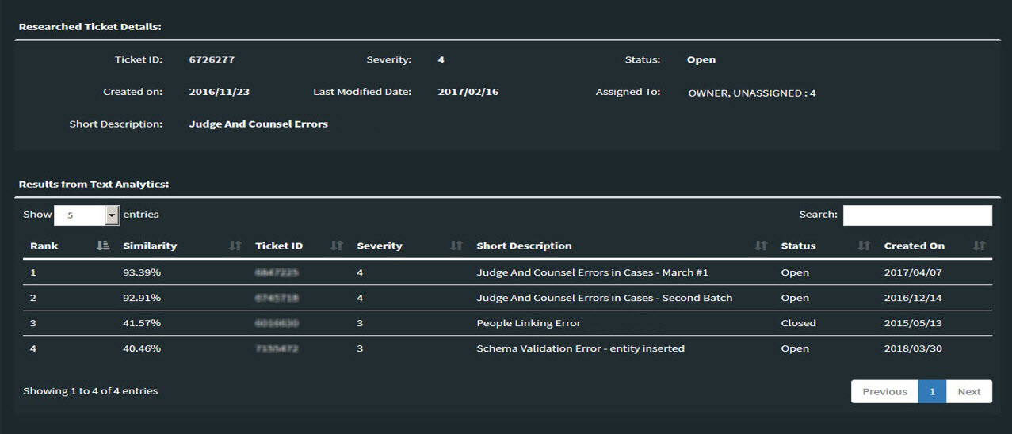

Slide 17





Dashboard / Data Portal
Request:
Ticket ID
Request:
Ticket ID
SKTheTester@gmail.com Sivakumar Ganesan SKTheTester@gmail. com
Response:
Matching Ticket(s) Information
Response:
Ticket details
Mongo DB
Sivakumar Ganesan SKTheTester@gmail.com Sivakumar Ganesan SKTheTester@gmail.com Sivakumar Ganesan SKTheTester@gmail. com Sivakumar Ganesan
Response:
Matched
Tickets
Request:
Ticket
details
Sivakumar Ganesan
http://skg.securyber.com
1
2
3
SKTheTester@gmail.com Sivakumar Ganesan SKTheTester@gmail. Com Sivakumar Ganesan SKTheTester@gmail.com Sivakumar Ganesan SKTheTester@gmail.com
Normalization
Vector Space Model
Topic Modeling
Tokenization
Text Cleaning
Stop Words Removal
POS Tagging
Lemmatization
All the documents are converted to list of vectors using “bag of words” or “TF-IDF” models
The vectors generated are processed through topic modeling algorithms like LSI or LDA
Normalized Document
Transformed Document
Sivakumar Ganesan SKTheTester@gmail.com Sivakumar Ganesan
Text Analytics Platform

Slide 18
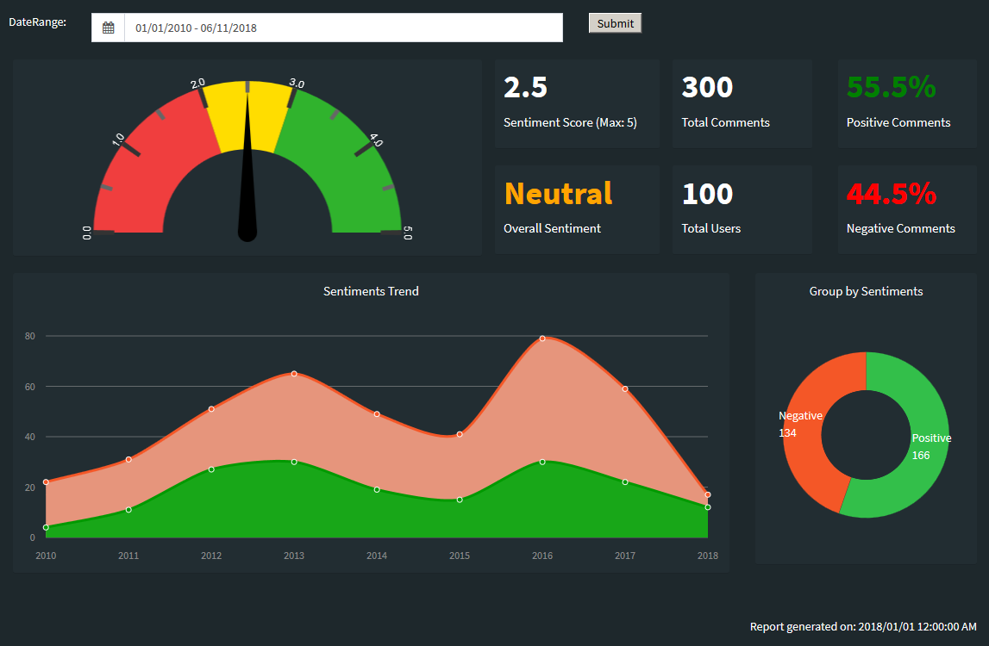
Notes:
One of the common problems in large organizations is the non-availability of a generic platform to generate analytics from unstructured data. For example, the customer sentiments are not available from user comments, feedback, production tickets and any other unstructured data which might provide valuable insight on the current state of products. I built a text analytics platform which takes any unstructured data as input and provide required insights based on the data type.

Slide 19
SKTheTester@gmail.com Sivakumar Ganesan SKTheTester@gmail. com
Sivakumar Ganesan SKTheTester@gmail.com Sivakumar Ganesan SKTheTester@gmail.com Sivakumar Ganesan SKTheTester@gmail. com Sivakumar Ganesan
SKTheTester@gmail.com Sivakumar Ganesan SKTheTester@gmail. Com Sivakumar Ganesan SKTheTester@gmail.com Sivakumar Ganesan SKTheTester@gmail.com
Sivakumar Ganesan SKTheTester@gmail.com Sivakumar Ganesan

Slide 20
Sivakumar Ganesan
http://skg.securyber.com

Slide 21
In traditional Waterfall approach, the Automation generally did not happen until after the release. Once the release is completed, the test cases were chosen for regression, feasibility analysis was done, and then the Automation was created for future Regression testing. In Agile, there’s no separate time to catch up on the automation. To avoid the lead time involved in automating the test cases, Behavioral Driven Development (BDD) approach was adapted using Cucumber test framework in GCS space.
Cucumber merges specification and test documentation into one cohesive whole. It provides the ability to write the features and test descriptions in ‘Gherkin’, a plain-text English with a little extra structure like Given-When-Then. Cucumber translates the BDD tests into Java step definitions, the building blocks to develop the automated scripts. These step definitions form the skeleton of the framework and it ties the automated scripts with test steps enabling very high reuse. The BDD tests and Java scripts are stored in Subversion (SVN), an open source revision control system. Jenkins, an open source automation server is used to schedule or run automated tests. Jenkins integrates with practically every tool in the continuous integration and continuous delivery toolchain, hence will act as the continuous build and delivery hub for all projects in future.
In 2017, several improvements are being made to this automation Framework.
Manual effort spent in collecting the test data will be reduced with “Dynamic Data Sourcing” – an automated test data driver that fetches the required test data based on user instructions in run time.
Creating “Smart Data” using techniques like Pattern recognition and prioritization to eliminate redundant test data and improve test effectiveness.
Replacing current singleton test reports with “Expert reports” – multifold reports in the form of Excel sheets, Email summary and Web dashboard providing holistic picture of the system health and trends over a period of time.
“Automated bug tracking” will help in isolating the new issues from already known issues and automatically log them.
D.A.V.I.S. Data Adaptive Virtual Intelligence System is being developed to continuously learn from the new items listed above, help and improve future test executions.
Benefits:
Feature descriptions and tests are written in Gherkin. Can be created and easily understood by non-technical people in the project.
High reuse of test steps and automated scripts within the project and between agile teams.
Helped in achieving over 80% in-sprint automation consistently.
Fast feedback to engineering teams – 10 minutes for BVT, 30 minutes for Smoke Tests and less than 8 hours for Regression.
Framework completely built with open source tools and no licensing cost involved.

Slide 23

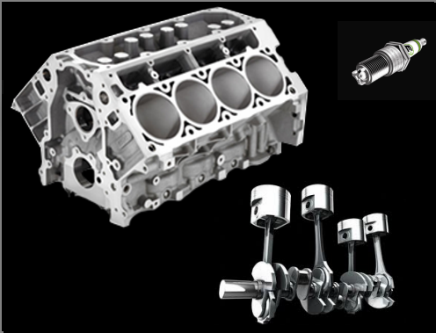
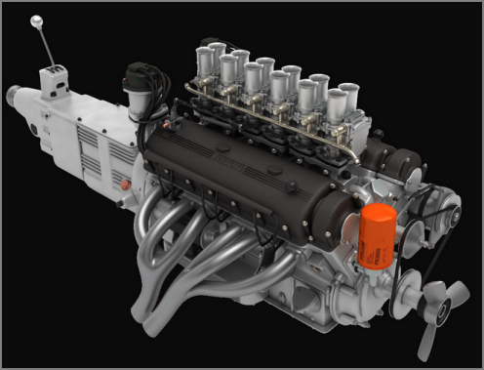

Frond End Application
Testing the engine parts individually.
(Component Testing)
Testing the whole engine before mounting in the car.
(Content Integration Testing)
Content or Data Based Backend Systems
Testing the engine by taking a test drive in the car.
(Content Application Integration)
Sivakumar Ganesan
http://skg.securyber.com

Slide 24







Current Scenario:
Content Integration Testing (CIT)
Content App Integration Testing (CAI)
App – Functional
Testing
+
Content
Development
Integration Phase
(2 Weeks)
6 Weeks Certification
~ 90% of Content Testing
Code Freeze
App Development
2 Weeks Integration
~ 10% of Content Testing
Certification Phase (6 Weeks)
Go Live
Proposed Shift Left Approach:
Content Integration Testing (CIT)
Content App Integration Testing (CAI)
Limited to Content Defect Retest
Content
Development
Integration Phase
(2 Weeks)
3 Weeks; ~ 30% of Content Testing
2 Weeks
Code Freeze
App Development
~ 3 to 4 Weeks Int; 1 Week in Cert.
~ 70% of Content Testing
Certification Phase (6 Weeks)
Go Live
App Development
reduced dependency on LA
reduced by 50%
Content Releases (HPCC, ICCE etc.)
App/PSS/Content Code Complete
App/PSS Code Freeze
Lexis Advance Release
XML Testing
Lexis Advance App Testing
*Slide has animations

Slide 25
As Is
Content Integration Testing
Content App Integration Testing (CAI)
App – Functional
Testing
+
Content
Development
Integration Phase
(2 Weeks)
6 Weeks Certification
~ 90% of Content Testing
Code Freeze
App Development
2 Weeks Integration
~ 10% of Content Testing
Certification Phase (6 Weeks)
Go Live
Shift Left Approach
Content Integration Testing
Content App Integration Testing (CAI)
Limited to Content Defect Retest
Content
Development
Integration Phase
(2 Weeks)
3 Weeks; ~ 30% of Content Testing
2 Weeks
Code Freeze
~ 3 to 4 Weeks Int; 1 Week in Cert.
~ 70% of Content Testing
Certification Phase (6 Weeks)
Go Live
App Development
App Development
reduced dependency on LA
reduced by 50%
Content Releases
App/PSS/Content Code Complete
App/PSS Code Freeze
Lexis Advance Release
XML Testing
Lexis Advance App Testing
*Slide has animations

Slide 26
Requirement Analysis
QA Test Planning
Test Execution
Go-Live
Business User
Manual Test Execution
Test scenario in Excel
Test Case in Excel
Deployment
Defect fix and Validation
UAT
Requirements,
Tech. specs
Post Go-Live
Automated QA script creation
Automated Test execution
Identifying Regression cases
Automation Feasibility Analysis
Automated Test Execution
Impact Analysis for change
Automation Framework (Ex: Selenium, QTP..)

Slide 27
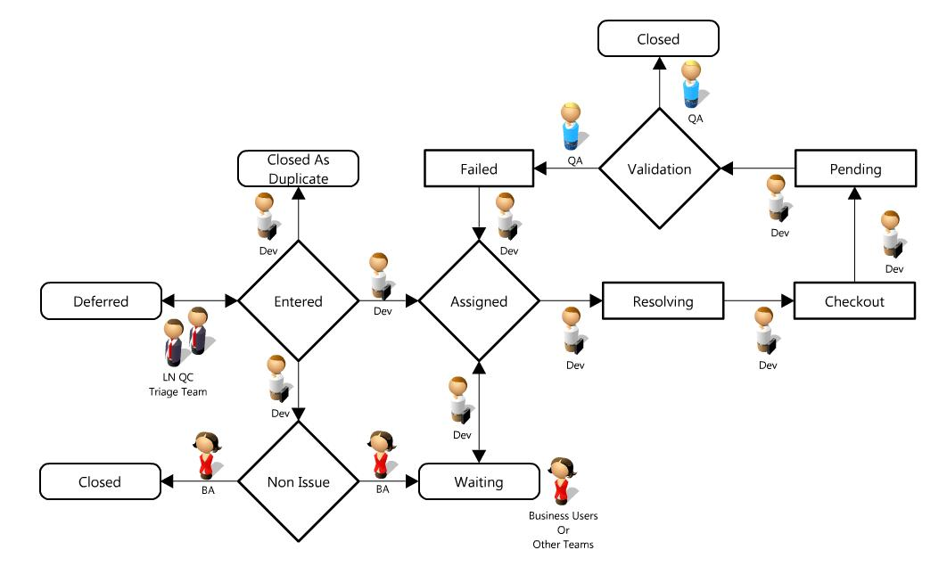
Notes:
Bug Workflow

